Slide 1

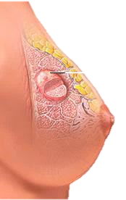
Breast Cancer
Prediction
SOS Pi Group 4
Notes:
There are certain characteristics in cell nuclei that will be used to determine the likelihood of breast cancer in patients.
These cell nuclei are collected using Fine Needle Aspiration (FNA) of breast masses.
These breast masses are extracts from the breast.

Slide 2
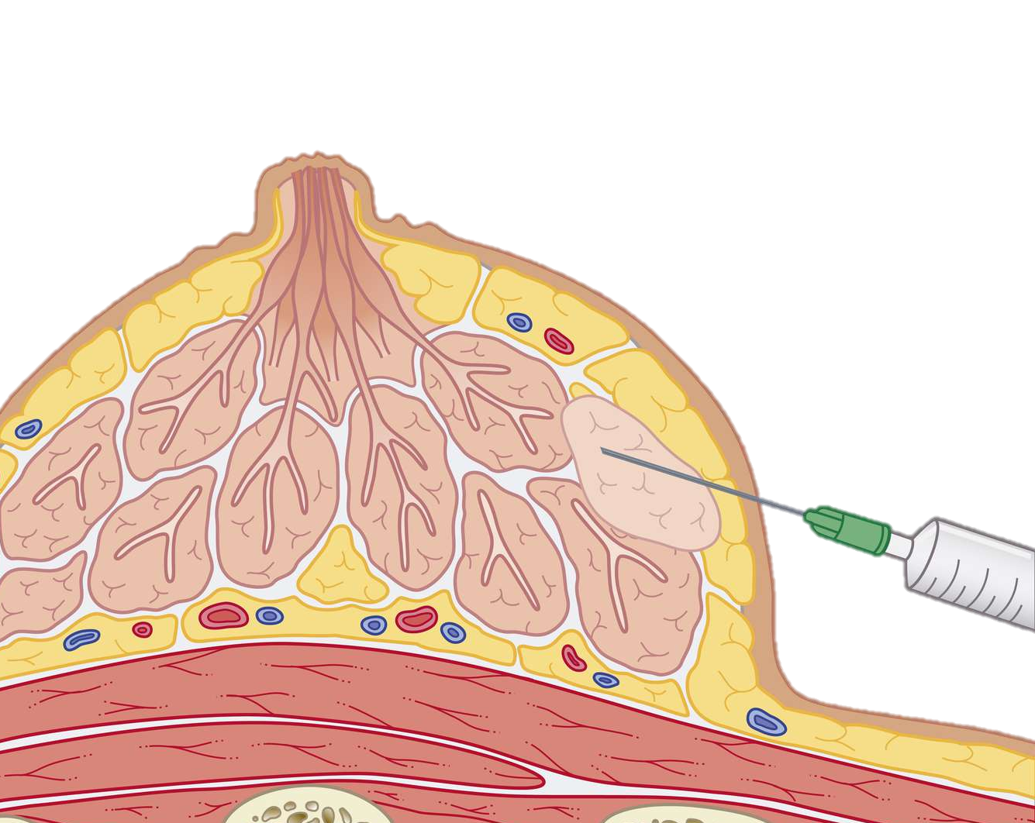
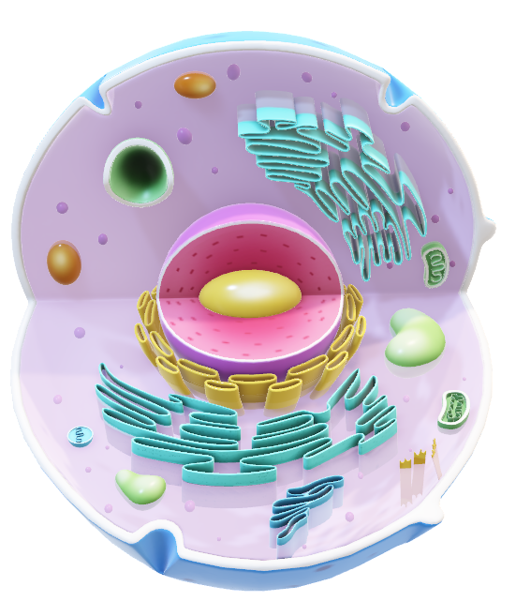
Fine Needle Aspiration (FNA) of breast masses
Cells are tiny building blocks

Slide 3
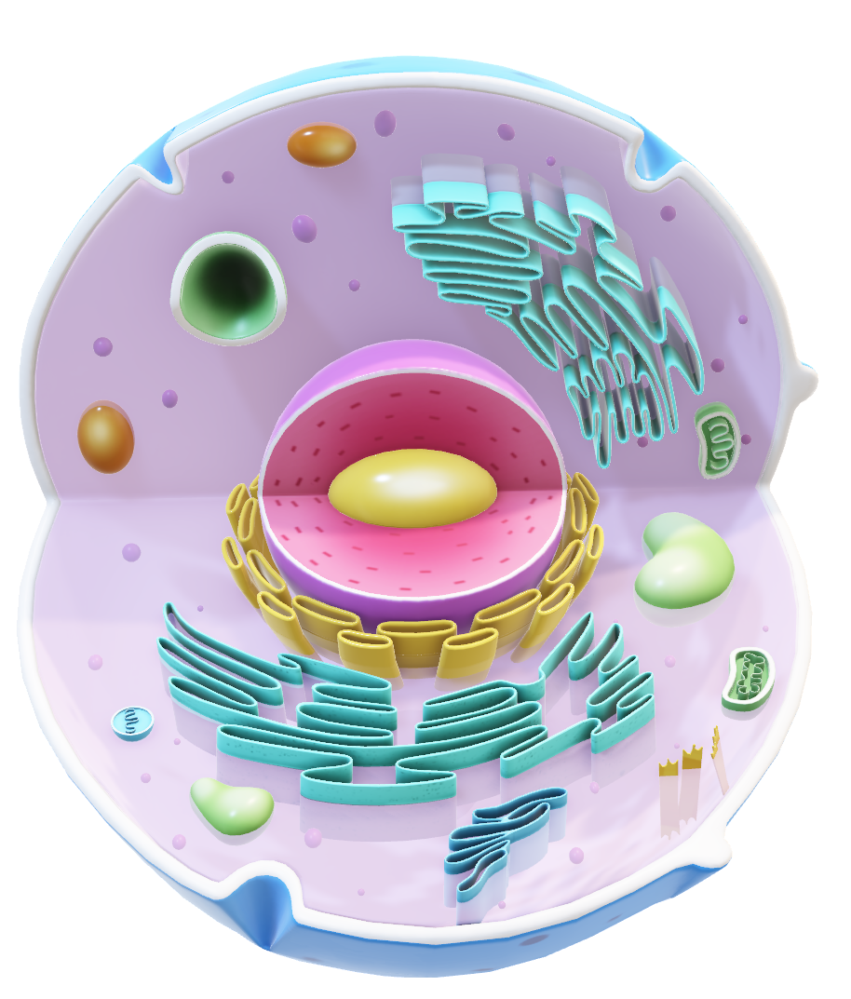
Cells are tiny building blocks
Fine Needle Aspiration (FNA) of breast masses

Slide 4

Nucleus

Slide 5

Real Valued Features of the Nucleus
‘M’
Malignant
Radius
Texture
Perimeter
Area
Smoothness
Compactness
Concave points
Symmetry
Fractal dimension
Fractal geometry
Benign
‘B’
Fine Needle Aspiration (FNA) of breast masses

Slide 6
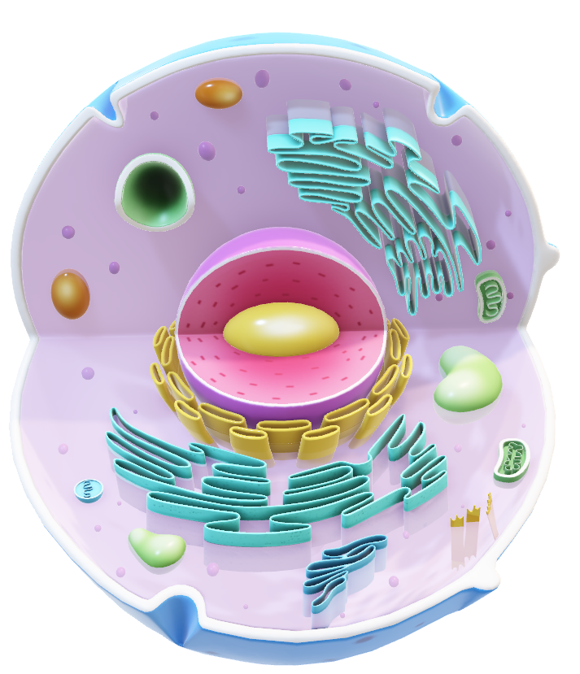
‘M’
Malignant
DATASET
DESCRIPTION
Benign
‘B’
Dataset Description
Real Valued Features of Nucleus
ID Number
Diagnosis
Radius
Texture
Perimeter
Area
Smoothness
Compactness
Concave points
Symmetry
Fractal dimension
Fractal geometry

Slide 7
Checked for missing values
Converted diagnosis to binary
Checked for duplicate rows
33
Number of Columns
3
Column Categories
10
No. features each
Mean
Std. Error
Worst Values
Data examination
Data cleaning

Slide 8
Checked for missing values
Converted diagnosis column to binary.
Checked for duplicate rows
33
Number of Columns
3
Column Categories
10
No. features each
Mean
Std. Error
Worst Values
Data examination
Data cleaning

Slide 9
Correlation Between
Diagnosis and Variables
100th
75th
PERCENTILE
25th
0th
Radius
Texture
Perimeter
Area
Smooth
Compact
Con Points
Symmetry
Frac dim
Frac geo

Slide 10
Training Models
Logistic Regression (0.98)
Support Vector Machine (0.96)
Gradient Boosting Classifier (0.96)
Artificial Neural Network (0.96)
Random forest (0.95)
K-Nearest Neighbors (0.95)
Naïve Bayes (0.95)
Decision Tree (0.95)
Logistic Regression
98%
Accuracy

Slide 11
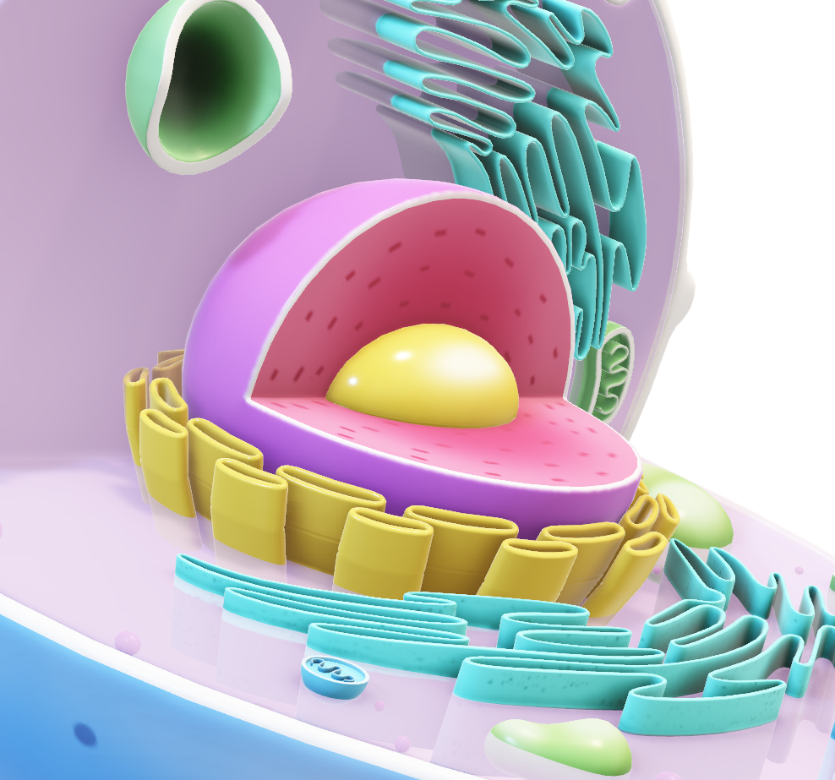
Nuclear Features of Malignancy
Concave points worst: 0.182
Areas worst: 1422.286
Smoothness mean: 0.103
Texture mean: 21.605
Radius standard error: 0.609
Symmetry standard error: 0.02
Concave points worst: 0.074
Areas worst: 558.899
Smoothness mean: 0.092
Texture mean: 17.915
Radius standard error: 0.284
Symmetry standard error: 0.021
Benign
Malignant
Unit of measure is micrometres (µm)
Notes:
1. Implementation of Predictive Models in Clinical Settings
Adopt Logistic Regression: Since Logistic Regression achieved the highest accuracy (97%) among the models tested, the firm should consider implementing this model in their diagnostic processes. This model’s simplicity and interpretability make it an excellent choice for real-time decision-making in clinical settings.
Explore Ensemble Methods: While Logistic Regression performed best, other models like Gradient Boosting Classifier and Support Vector Machine also showed high accuracy (96%). The firm could explore ensemble methods that combine these models to potentially improve prediction accuracy and robustness.
2. Feature Importance in Diagnostics
Focus on Key Nuclear Features: Features such as radius_worst, concave points_worst, and compactness_worst were identified as critical indicators of malignancy. The firm should emphasize these features in their diagnostic protocols, as they are strong predictors of cancer.
Integrate Feature Analysis: The firm could develop tools that highlight these critical features during FNA analysis, helping radiologists and pathologists to make more informed decisions quickly.
3. Automation and Workflow Integration
Automate Data Processing: The firm should invest in automating the data cleaning and preprocessing steps. This includes handling missing values, converting diagnosis columns to binary, and checking for duplicates. Automation will streamline the workflow, reduce human error, and ensure consistent data quality.
Integrate Predictive Tools into Existing Systems: The predictive models should be integrated into the firm’s existing healthcare systems, allowing seamless data flow and real-time predictions. This integration will enhance the efficiency of breast cancer diagnostics and ensure that the models are used effectively.
4. Training and Education
Training for Medical Staff: The firm should provide training for medical staff on how to interpret the results from the predictive models, particularly the importance of nuclear features in diagnosis. This will ensure that the models are used effectively in clinical practice.
Continuous Learning and Model Updating: Encourage a culture of continuous learning where staff are regularly updated on new findings and model improvements. The firm should also regularly update the models with new data to maintain high accuracy and relevance.
5. Further Research and Development
Research on Additional Features: While the current analysis focuses on specific nuclear features, the firm should invest in research to explore additional features that might improve prediction accuracy. For example, integrating genetic or molecular data with the current features could enhance model performance.
Pilot Testing and Feedback Loops: Before full-scale implementation, the firm should conduct pilot tests of the models in real-world clinical settings. Collecting feedback from these pilots will help refine the models and the integration process.

Slide 12

Recommendations for the firm
Implementation of Predictive Models in Clinical Settings
Feature Importance in Diagnostics
Automation and Workflow Integration
Training and Education
Further Research and Development
Radius worst: 21.135
Fractal dimension mean: 0.063
Concave points worst: 0.182
Concavity mean: 0.161
Compactness worst: 0.375
Permitter standard error: 4.324
Malignant
Notes:
1. Implementation of Predictive Models in Clinical Settings
Adopt Logistic Regression: Since Logistic Regression achieved the highest accuracy (97%) among the models tested, the firm should consider implementing this model in their diagnostic processes. This model’s simplicity and interpretability make it an excellent choice for real-time decision-making in clinical settings.
Explore Ensemble Methods: While Logistic Regression performed best, other models like Gradient Boosting Classifier and Support Vector Machine also showed high accuracy (96%). The firm could explore ensemble methods that combine these models to potentially improve prediction accuracy and robustness.
2. Feature Importance in Diagnostics
Focus on Key Nuclear Features: Features such as radius_worst, concave points_worst, and compactness_worst were identified as critical indicators of malignancy. The firm should emphasize these features in their diagnostic protocols, as they are strong predictors of cancer.
Integrate Feature Analysis: The firm could develop tools that highlight these critical features during FNA analysis, helping radiologists and pathologists to make more informed decisions quickly.
3. Automation and Workflow Integration
Automate Data Processing: The firm should invest in automating the data cleaning and preprocessing steps. This includes handling missing values, converting diagnosis columns to binary, and checking for duplicates. Automation will streamline the workflow, reduce human error, and ensure consistent data quality.
Integrate Predictive Tools into Existing Systems: The predictive models should be integrated into the firm’s existing healthcare systems, allowing seamless data flow and real-time predictions. This integration will enhance the efficiency of breast cancer diagnostics and ensure that the models are used effectively.
4. Training and Education
Training for Medical Staff: The firm should provide training for medical staff on how to interpret the results from the predictive models, particularly the importance of nuclear features in diagnosis. This will ensure that the models are used effectively in clinical practice.
Continuous Learning and Model Updating: Encourage a culture of continuous learning where staff are regularly updated on new findings and model improvements. The firm should also regularly update the models with new data to maintain high accuracy and relevance.
5. Further Research and Development
Research on Additional Features: While the current analysis focuses on specific nuclear features, the firm should invest in research to explore additional features that might improve prediction accuracy. For example, integrating genetic or molecular data with the current features could enhance model performance.
Pilot Testing and Feedback Loops: Before full-scale implementation, the firm should conduct pilot tests of the models in real-world clinical settings. Collecting feedback from these pilots will help refine the models and the integration process.

Slide 13





TEAM
SOS Pi Group 4

Slide 14





TEAM
MAVIS
Our lovely head tutor 💕

Slide 15
Thank you!
SOS Pi Group 4

Slide 16

Todos
Reduce technical jargons.
Explain that breast masses are extracted and cells in these masses are viewed to check the characteristic of their nucleus.
Train a model to predict based on learned data.
Being able to predict breast cancer.
Logistic regression, with 97% accuracy to make the prediction.

